Slide 1
Data Science Workshop

Slide 2
What is Data Science?
Definition: Data Science is the field that combines domain expertise, programming skills, and knowledge of mathematics and statistics to extract meaningful insights from data.
AI vs ML vs DS
Importance:
Transforms raw data into actionable insights.
Helps businesses and industries make informed decisions.
Drives innovation in fields like healthcare, finance, and marketing.

Slide 3
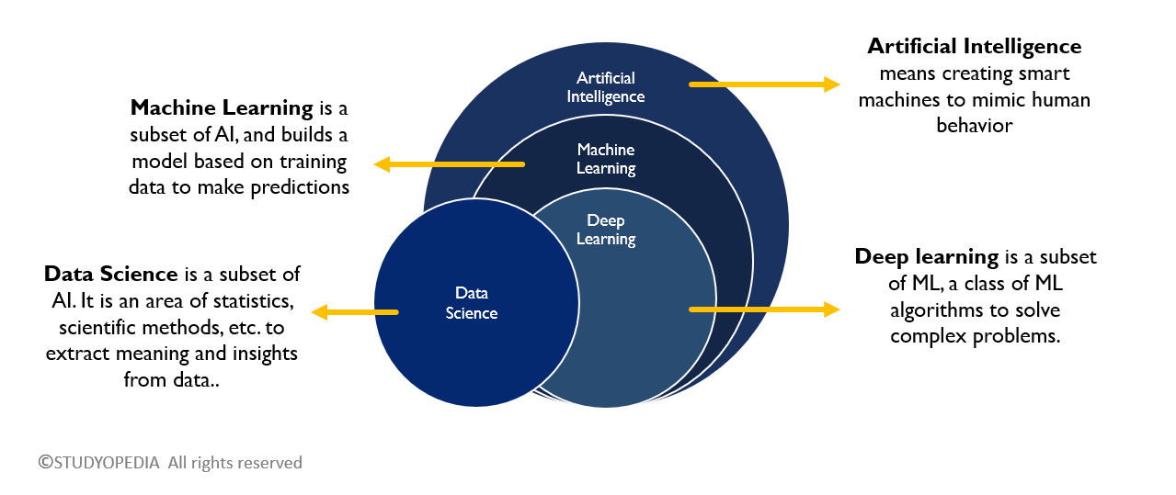

Slide 4
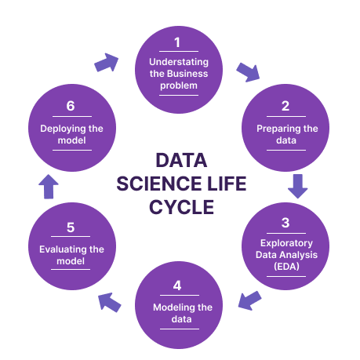
Data Science Lifecycle?
Problem Definition: Understanding the business problem.
Data Collection: Gathering relevant data from various sources.
Data Cleaning: Removing inconsistencies and handling missing data.
Exploratory Data Analysis (EDA): Visualizing data and uncovering patterns.
Model Building: Applying machine learning or statistical models.
Model Evaluation: Assessing model performance.
Deployment: Implementing the model in a production environment.

Slide 5
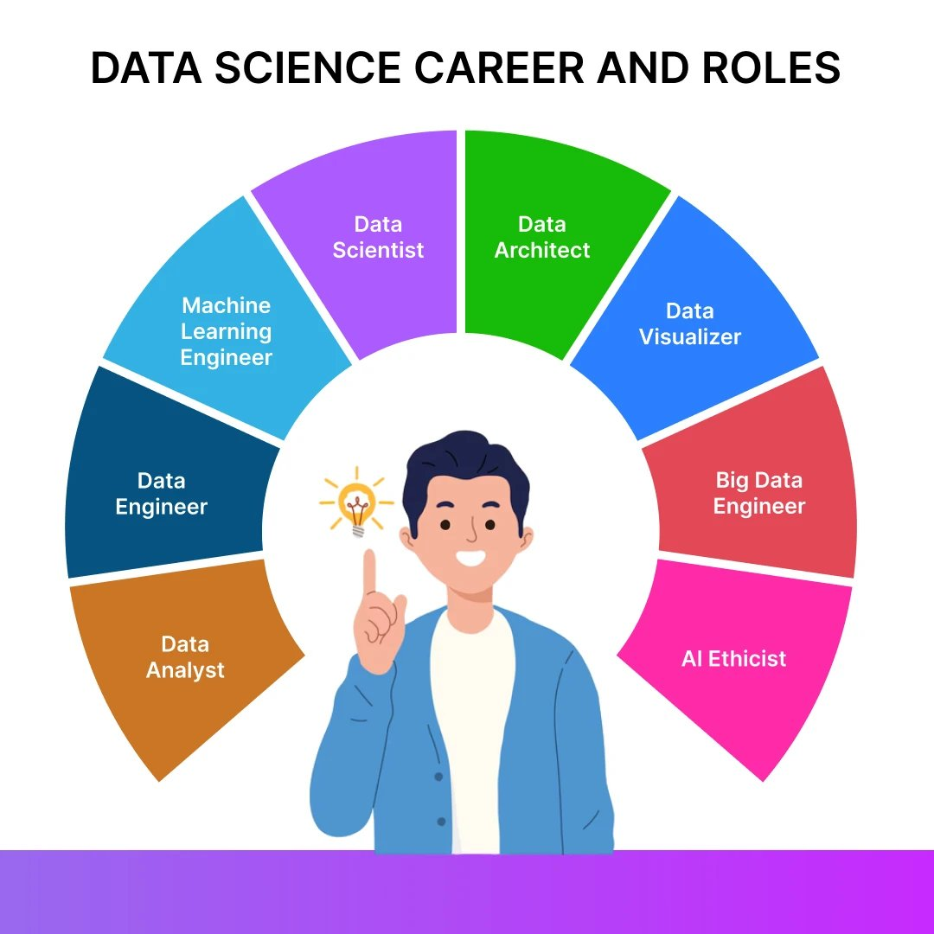
Key Roles in Data Science
Data Scientist: Focuses on creating models, interpreting data, and generating actionable insights.
Data Analyst: Focuses on analyzing data and providing visual reports.
Data Engineer: Works on designing and managing data pipelines and infrastructures.
Machine Learning Engineer: Specializes in deploying machine learning models at scale.
Business Analyst: Works closely with stakeholders to understand business requirements and translate them into data problems.

Slide 6
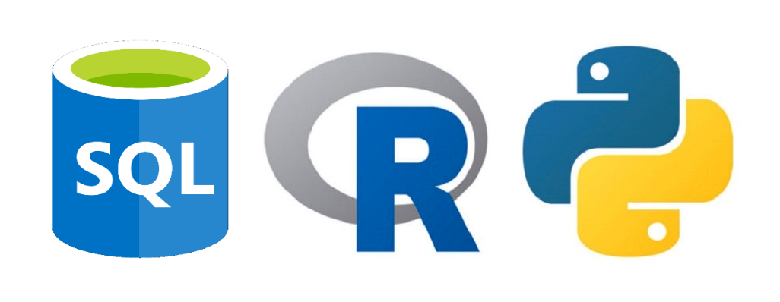
Essential Tools in Data Science
Python:
Libraries like Pandas, NumPy, Matplotlib, and Scikit-Learn for data manipulation and analysis.
Python is widely used due to its simplicity and rich ecosystem for data science.
R:
A programming language used primarily for statistical analysis and visualization.
Libraries like ggplot2, dplyr, and caret are popular in R.
SQL:
Structured Query Language is essential for querying relational databases.
Helps in data extraction, manipulation, and aggregation.

Slide 7
Outcome of Workshop
Skills Acquired:
Understand the Data Science lifecycle from problem definition to model deployment.
Clean and preprocess data to handle inconsistencies, missing values, and outliers.
Perform Exploratory Data Analysis (EDA) to uncover insights and patterns.
Apply machine learning algorithms to solve real-world problems.
Effectively communicate data-driven insights to diverse audiences.
Tools and Libraries:
Proficiency in Python programming.
Expertise in libraries like NumPy, Pandas, Matplotlib, and Seaborn for data analysis and visualization.
Capstone Project:
Students will complete a capstone project on Titanic survival prediction
Github repo: GitHub Repository.

Slide 8
Setup
Colab / Jupyter notebook: Best for writing and debugging python code.
Vscode / pycharm: Code editor for writing production level code.
Github Account: Use for maintaining the code.

